Slide 1

Ajay Kumar Garg Engineering College MINI Project / Internship Presentation
PRESENTED BY :
Sumit gaurav
(2000270130172)

Slide 2
Contents
-> Introduction.
-> About the Company.
-> Role and Responsibility.
-> About the Projects.
->Apni-Dukaan.
-> Technology Used.
-> Certificate.
-> Key takeaways.
-> Conclusion.

Slide 3
INTRODUCTION
I’m SUMIT GAURAV , and I'm excited to share my summer internship experience with you. I've had the privilege of working with CodSoft in Web Development and Designing Domain , Over the past 1 month and it's been an incredible journey of learning and growth. Today, I'll walk you through my key projects, skills gained, challenges faced, and valuable takeaways.

Slide 4

About the Company
CodSoft is an organization dedicated to training and empowering the youth, by encouraging them to explore the vast and uncharted world of technology and other areas of tremendous growth.
The institute is active in the field of training from several years and has produced a number of professionals.
This institute is specialized in providing training to the students of B.Tech, M. Tech., MCA, BCA and other students who are pursuing course in computer related technologies.
The training program is offered in several modules and in different technologies.

Slide 5
Role and Responsibility
During my summer training as a web developer and Designing intern, I had the privilege of working on a many of projects that allowed me to gain valuable experience . I was responsible for a wide range of tasks , this included :-
Front-end development, where I created responsive web pages using HTML, CSS, and JavaScript, as well as assisting with user interface and user experience enhancements.
On the back-end, I worked on server-side scripts and APIs, managed databases.
These responsibilities collectively enriched my web development skills and provided valuable insights into the dynamic world of web development.

Slide 6
About the Projects
During my summer internship, I had the opportunity to work on several impactful projects that allowed me to apply my skills and also helped to get an overview of how websites work . Here's a brief overview of the projects which I have completed during my internship :-
Apni-Dukaan
https://it3-apni-dukaan.vercel.app/

Slide 7
Apni-Dukaan
This project aimed to replicate Online Shopping website use can also filter different category
Tech Used : HTML, CSS, JavaScript.
Features :-
An attractive homepage that serves as the landing page for the website.
Consist of user registration and login pages.
Implement user authentication to allow registered users to leave reviews and ratings.
Include a navigation bar with links to different sections of the website.
A search bar to allow users to search for Products by Category,Product Name
User can checkout the item in the cart section

Slide 8
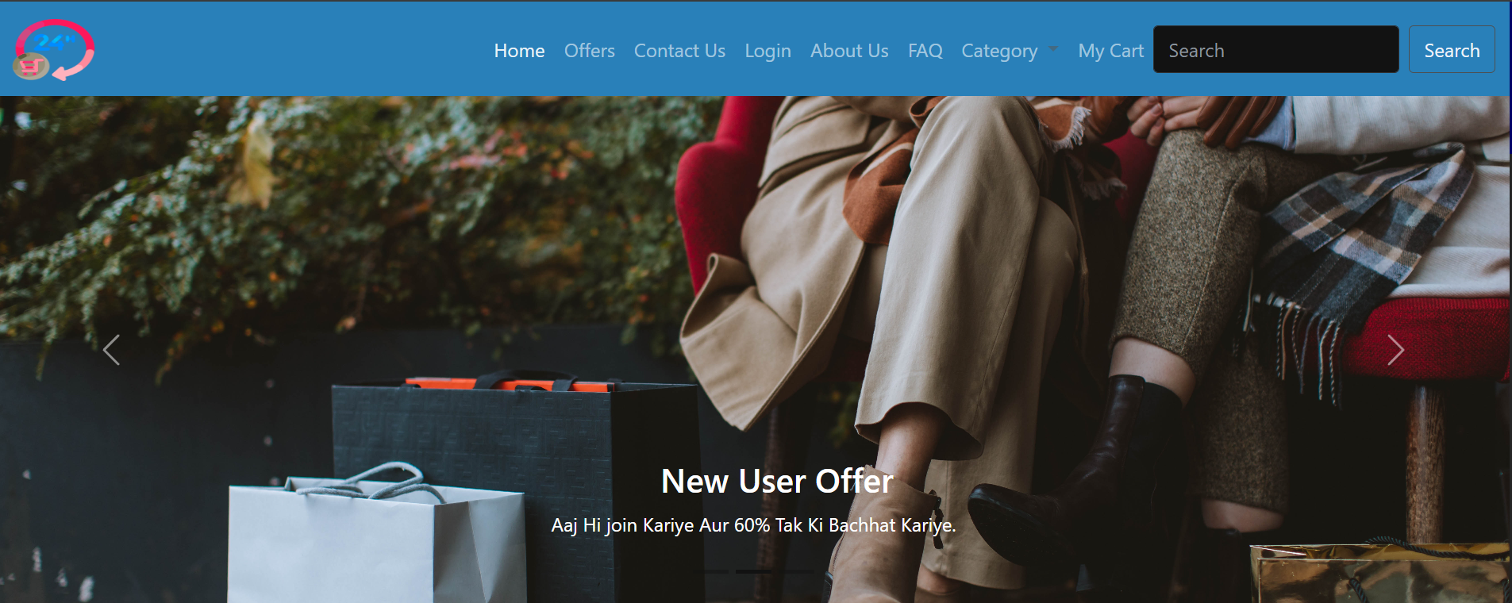
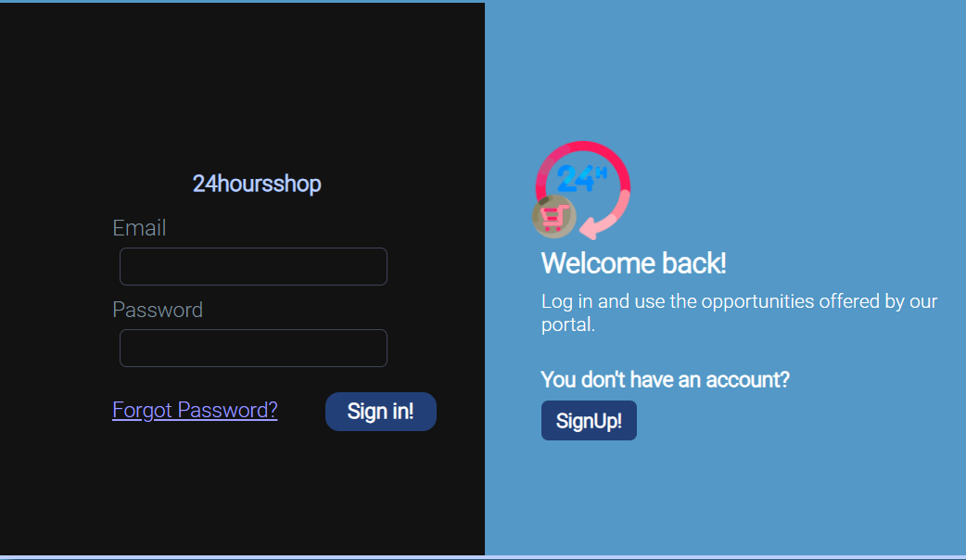
.
Home Page
Login Page

Slide 9
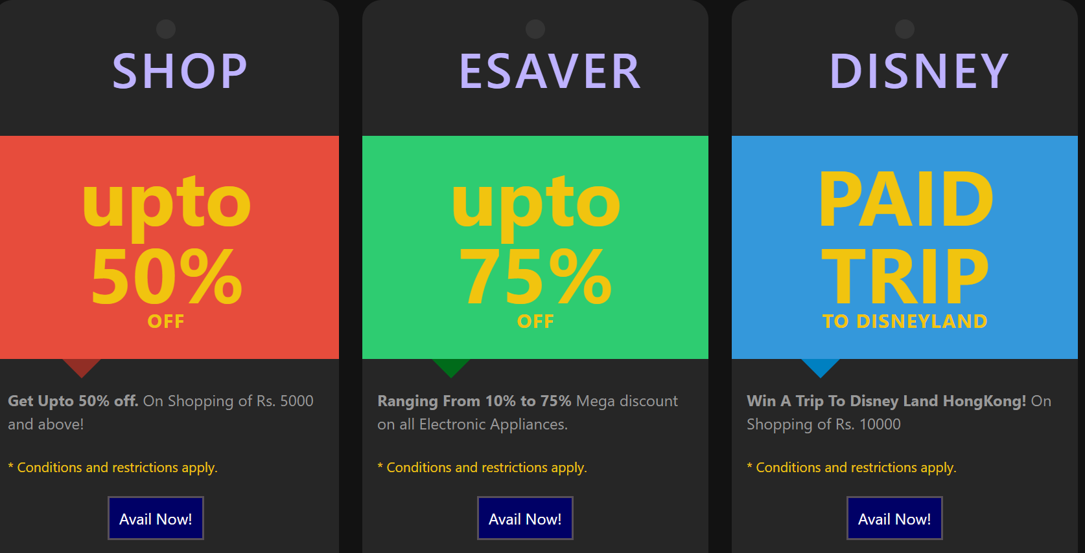
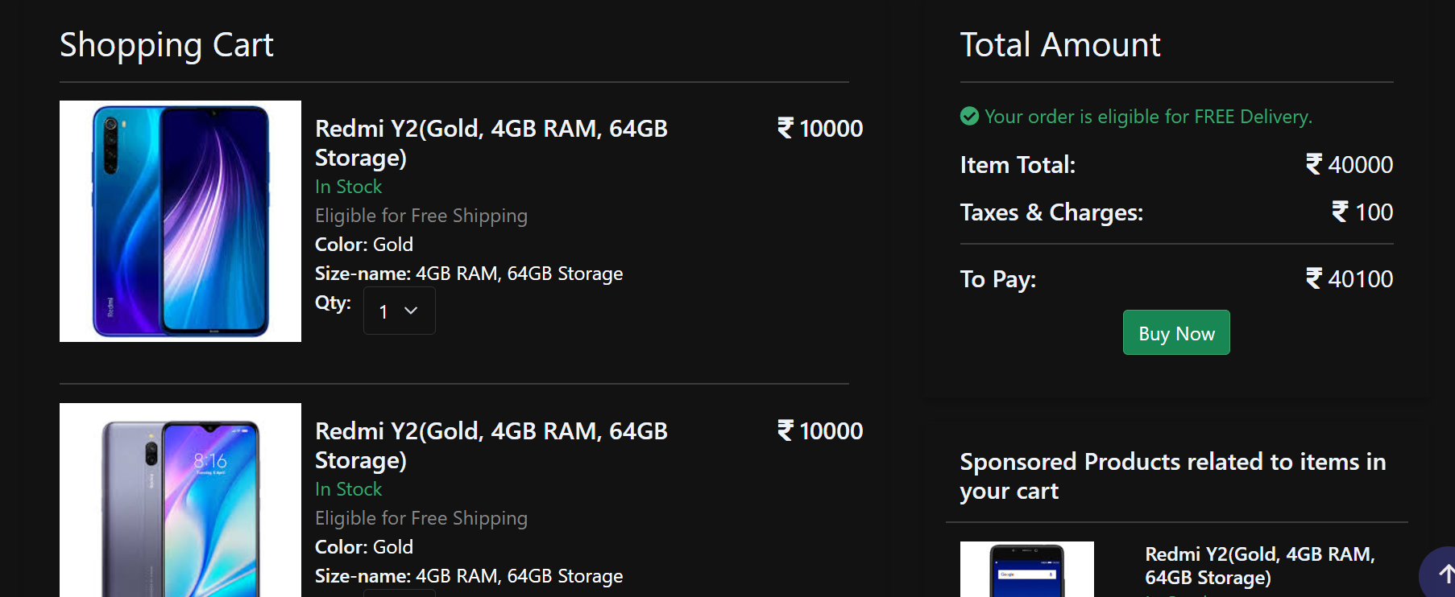
Offer Page My Cart Page

Slide 10
Technology Used
Throughout my summer internship, I had the privilege of working with the powerful HTML,CSS and Javavascript which is a combination of our key technologies:
HTML:In an online shopping website project, HTML (Hypertext Markup Language) serves as the backbone, defining the structure and content of web pages.
CSS: In an online shopping website project, CSS (Cascading Style Sheets) plays a crucial role in determining the website's appearance, layout, and user experience.
Javascript:JavaScript plays a critical role in enhancing the functionality and interactivity of an online shopping website.

Slide 11
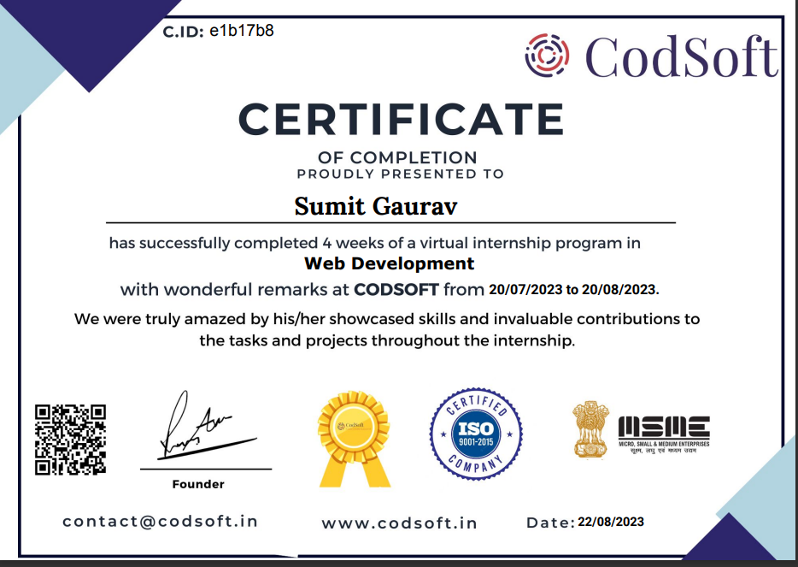
Certificate

Slide 12
Key takeaways
The internship was a remarkable learning journey, enhancing my skills in front-end and development, as well as my problem-solving abilities.
The internship has resulted in a portfolio of web development projects that will serve as a testament to my capabilities and contributions.
Acquired skills for full-stack web development using HTML,CSS,and Javascript,
Enhanced problem-solving skills through debugging and troubleshooting complex issues.
Improved communication skills through team collaboration and regular updates.
Embraced a culture of ongoing learning to stay updated with Front End Development advancements and best practices.

Slide 13
Conclusion
In conclusion, my web development summer training has been a transformative experience. I've not only honed my technical skills but also learned the significance of effective teamwork and adaptability in a professional setting. This journey of growth and learning has equipped me with practical experience, a portfolio of tangible achievements, and a network of valuable professional connections. I'm excited to carry these insights forward as I continue my career in web development, knowing that this internship has laid a strong foundation for my future endeavors in this dynamic field.

Slide 14
THANK YOU!

